Slide 1
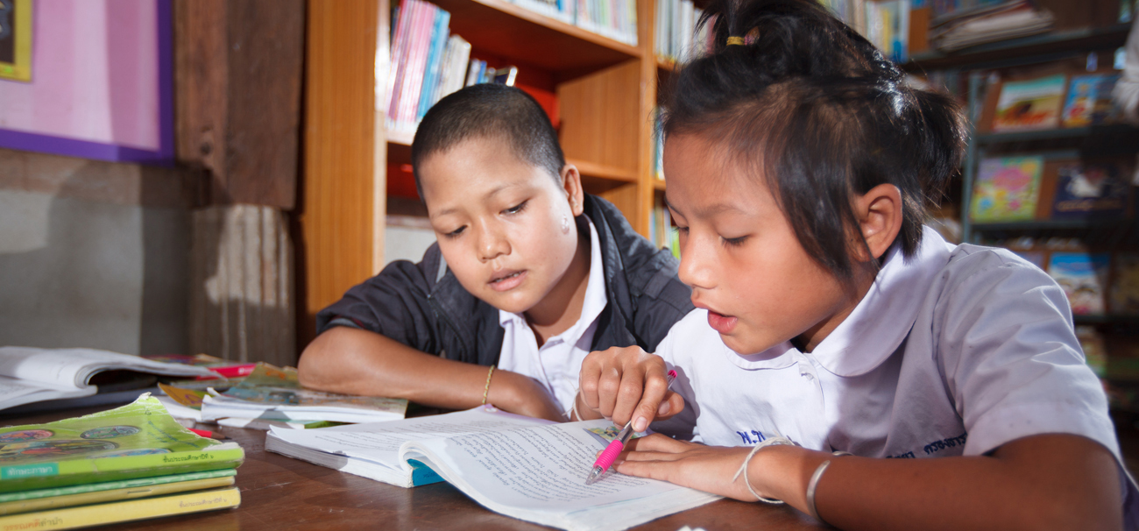
Leave No One Behind:
Gender-transformative and inclusive education
akturer/Shutterstock.com
© UNESCO

Slide 2
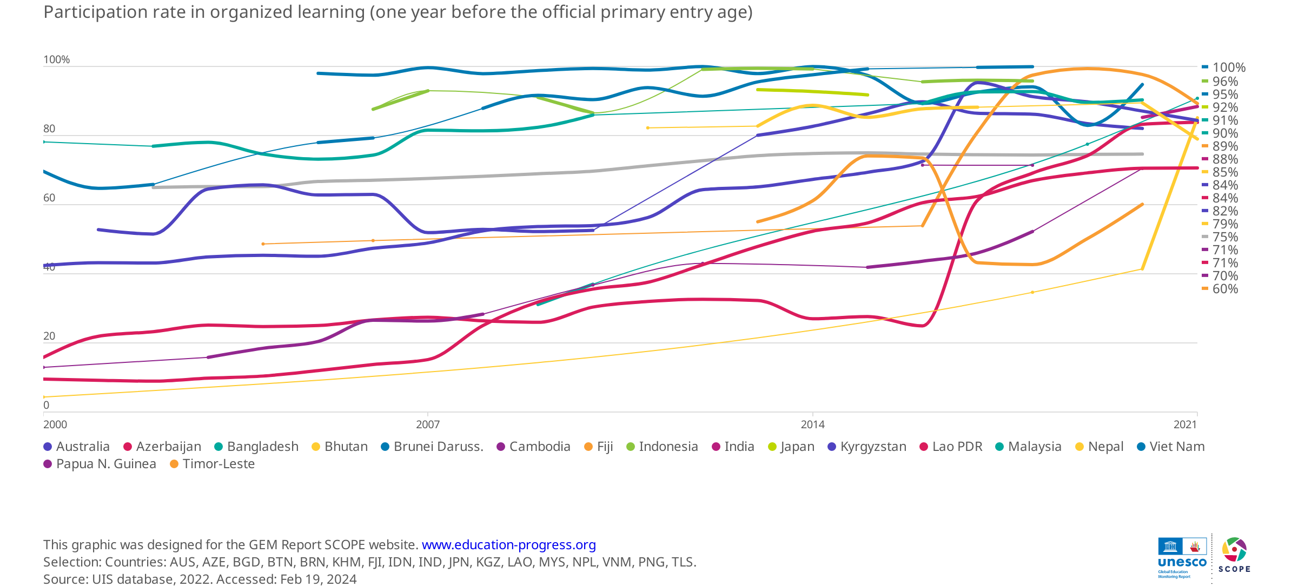
Globally, three in four students attend pre-primary one year before primary
Leave No One Behind: Gender-transformative and inclusive education

Slide 3
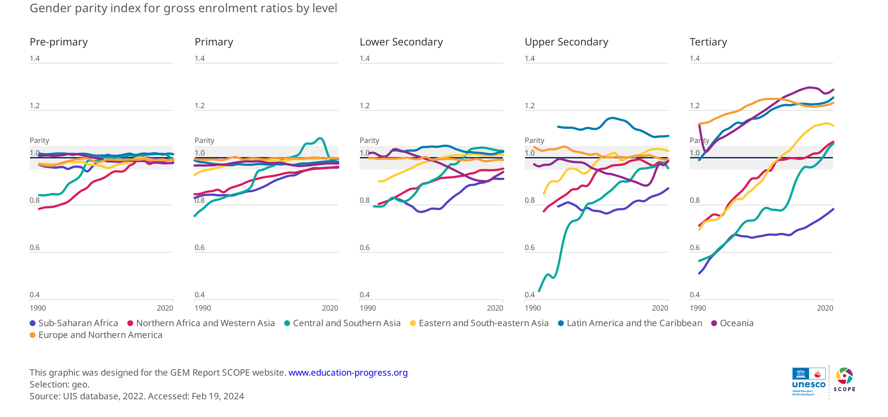
We have made significant progress towards gender parity around the world…
Leave No One Behind: Gender-transformative and inclusive education

Slide 4
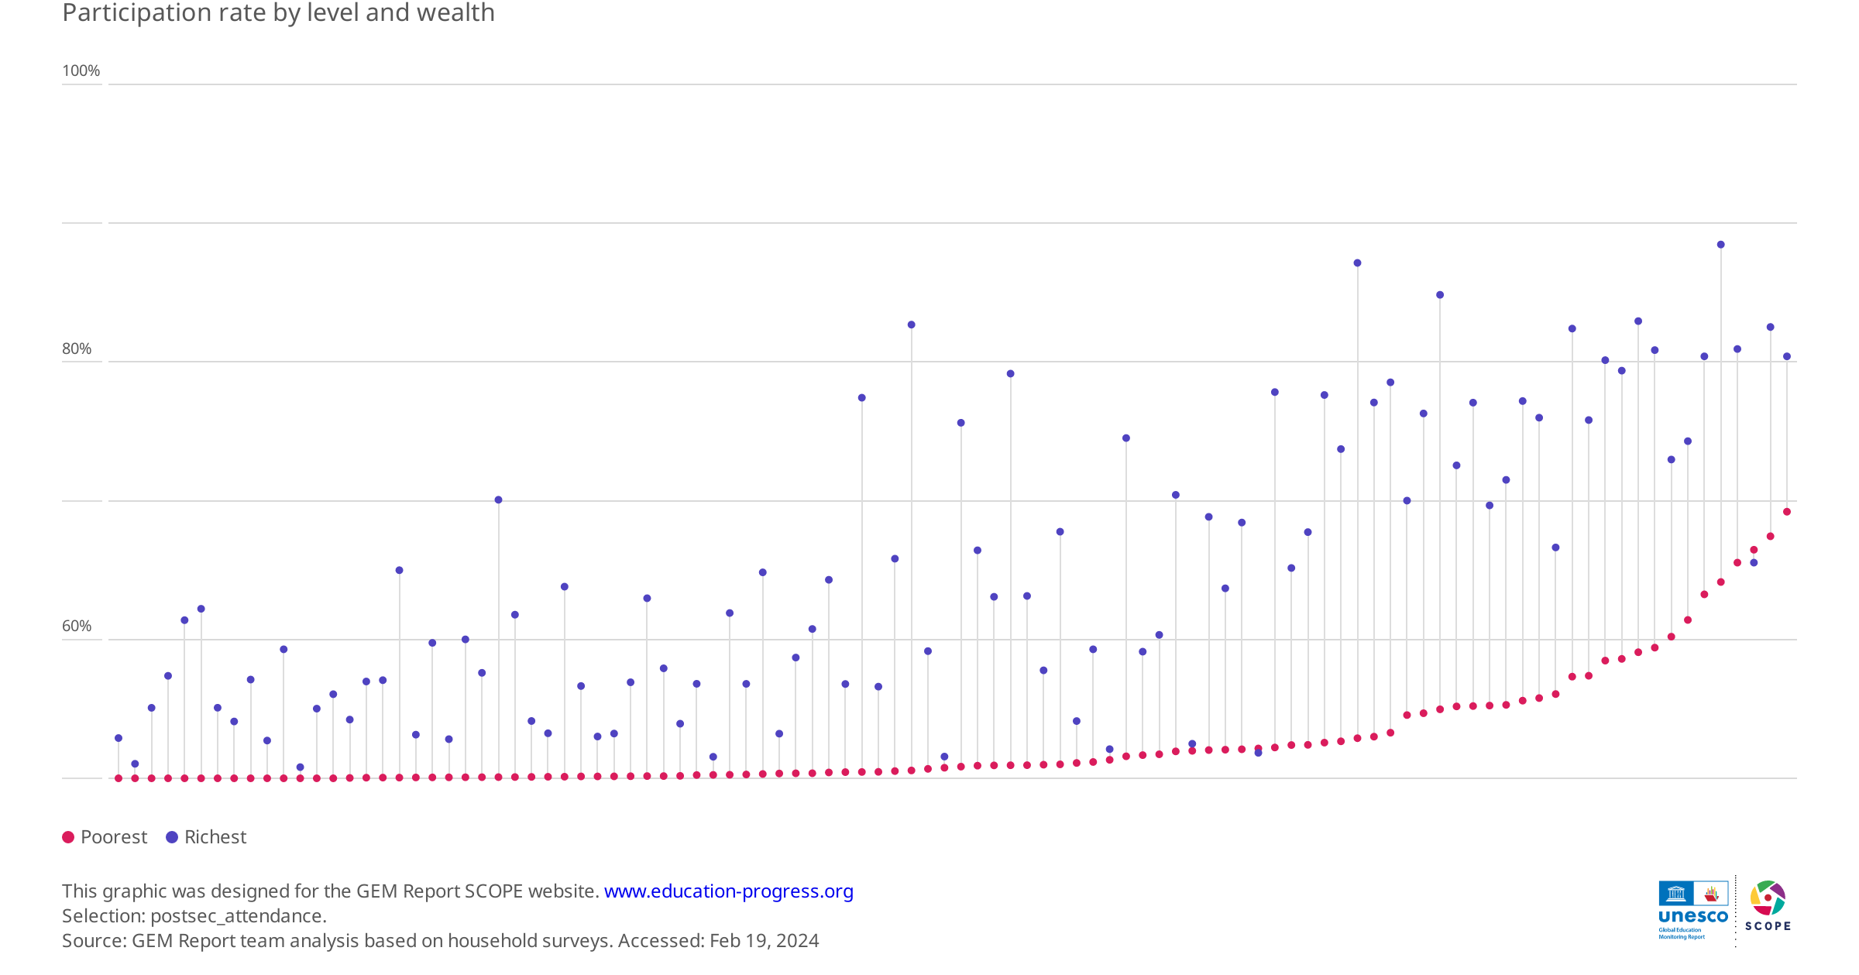
The poorest have hardly any post-secondary education opportunities in low- and middle-income countries
Mongolia
Poorest 10%
Richest 70%
Myanmar
Poorest 1%
Richest 32%
Lao PDR
Poorest 0%
Richest 30%
Viet Nam
Poorest 5%
Richest 55%
Leave No One Behind: Gender-transformative and inclusive education

Slide 5
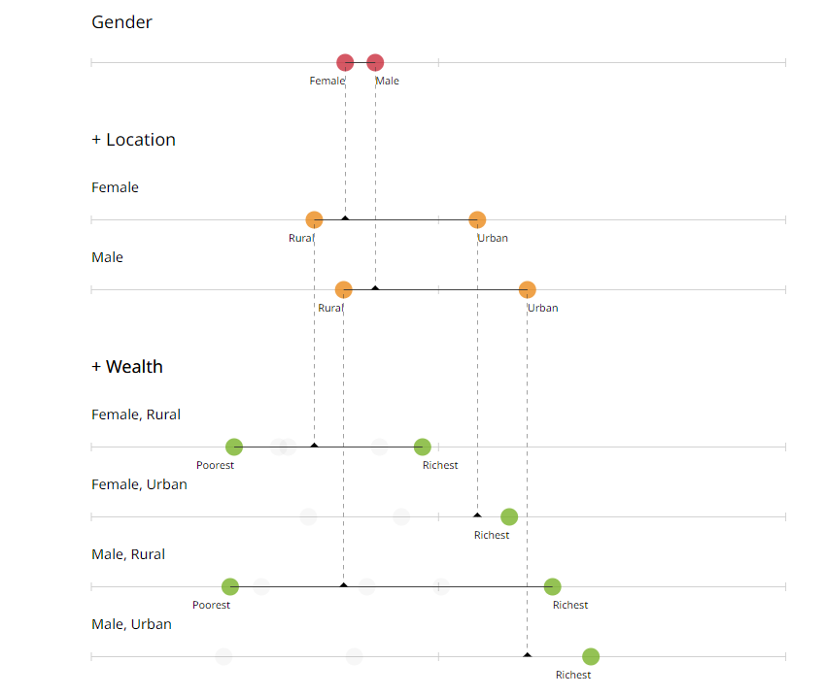
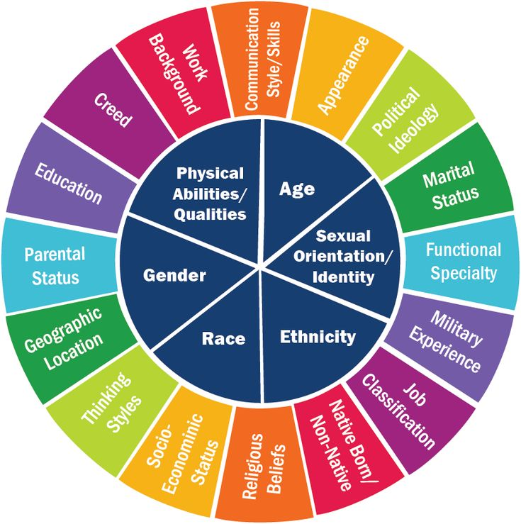
Example: Gender disparities in out of school youth in Cambodia
To understand the intersection of inequities
we need more intersectional data
63%
59%
68%
44%
64%
37%
79%
52%
40%
80%
30%
28%
Leave No One Behind: Gender-transformative and inclusive education

Slide 6
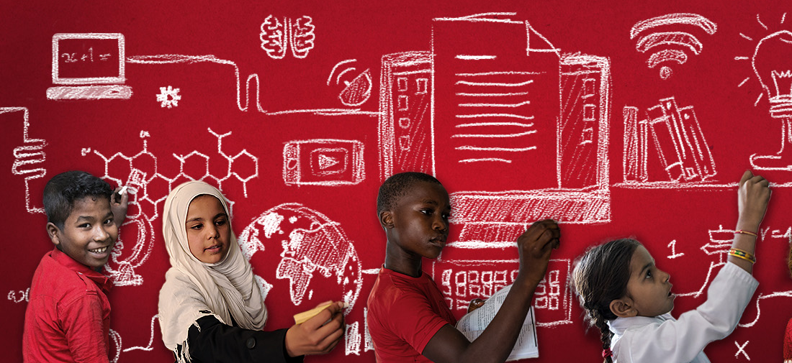

Transforming Education Summit
Leave No One Behind: Gender-transformative and inclusive education

Slide 7
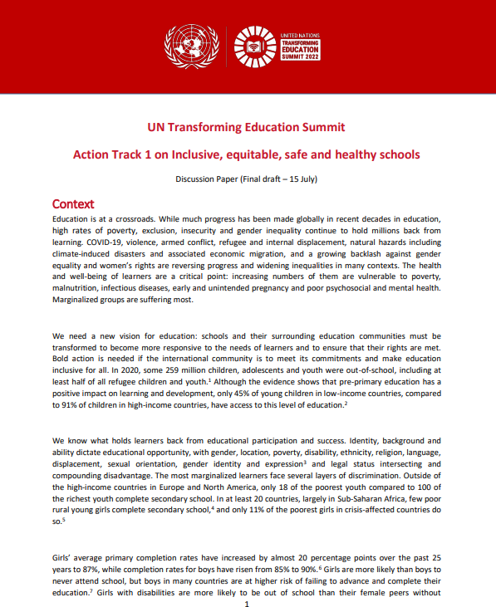

Transforming Education Summit
https://transformingeducationsummit.sdg4education2030.org/CTAGirls
Leave No One Behind: Gender-transformative and inclusive education

Slide 8
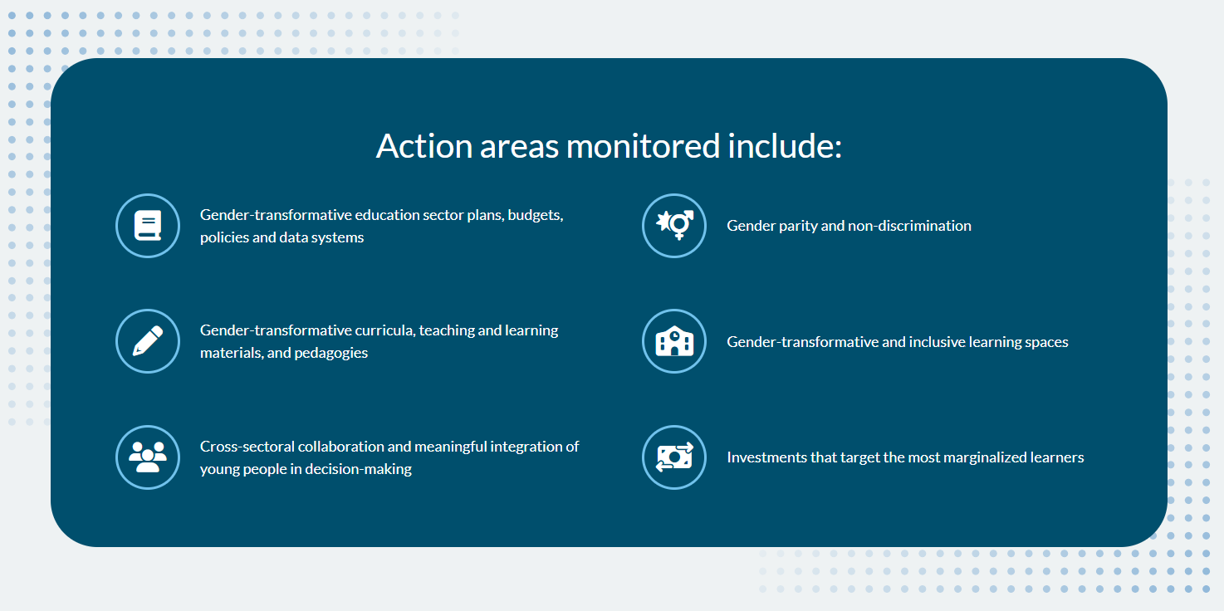
Areas of action
Leave No One Behind: Gender-transformative and inclusive education

Slide 9
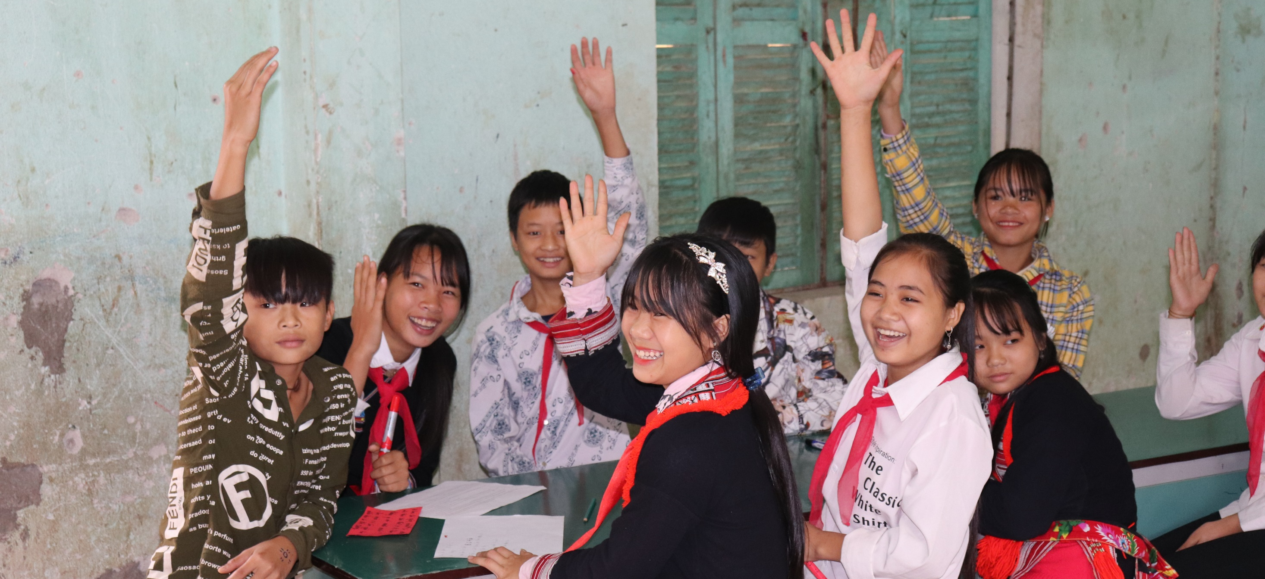
Gender-transformative education sector plans, budgets, policies & data systems
© UNESCO
Leave No One Behind: Gender-transformative and inclusive education

Slide 10
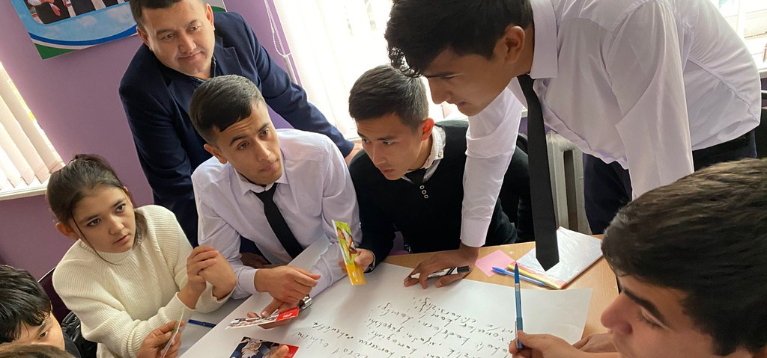
Gender-transformative curricula, teaching materials and pedagogies
© UN Uzbekistan
Leave No One Behind: Gender-transformative and inclusive education

Slide 11
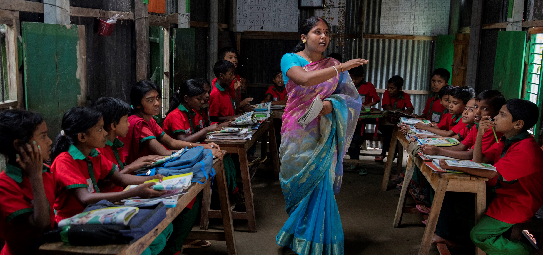
Ensuring gender parity and non-discrimination at all levels and in all subjects of education
© World Bank/Dominic Chavez
Leave No One Behind: Gender-transformative and inclusive education

Slide 12
Gender-transformative and inclusive learning spaces
© UNESCO Bangkok
© UNESCO

Slide 13
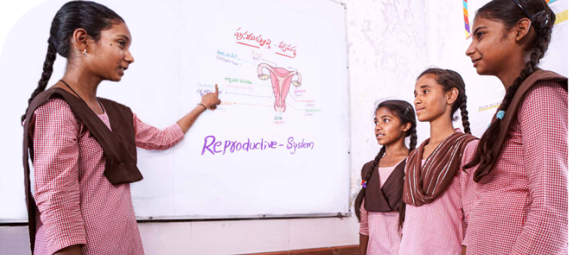
Cross-sectoral collaboration and meaningful engagement of young people in decision-making
© UNESCO
Leave No One Behind: Gender-transformative and inclusive education

Slide 14
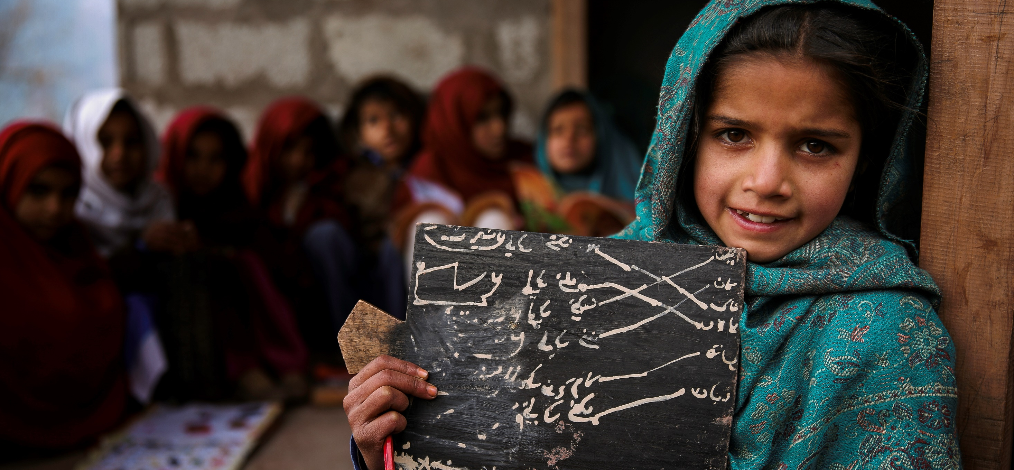
Investments that target the most marginalized learners
© UNESCO
Leave No One Behind: Gender-transformative and inclusive education

Slide 15
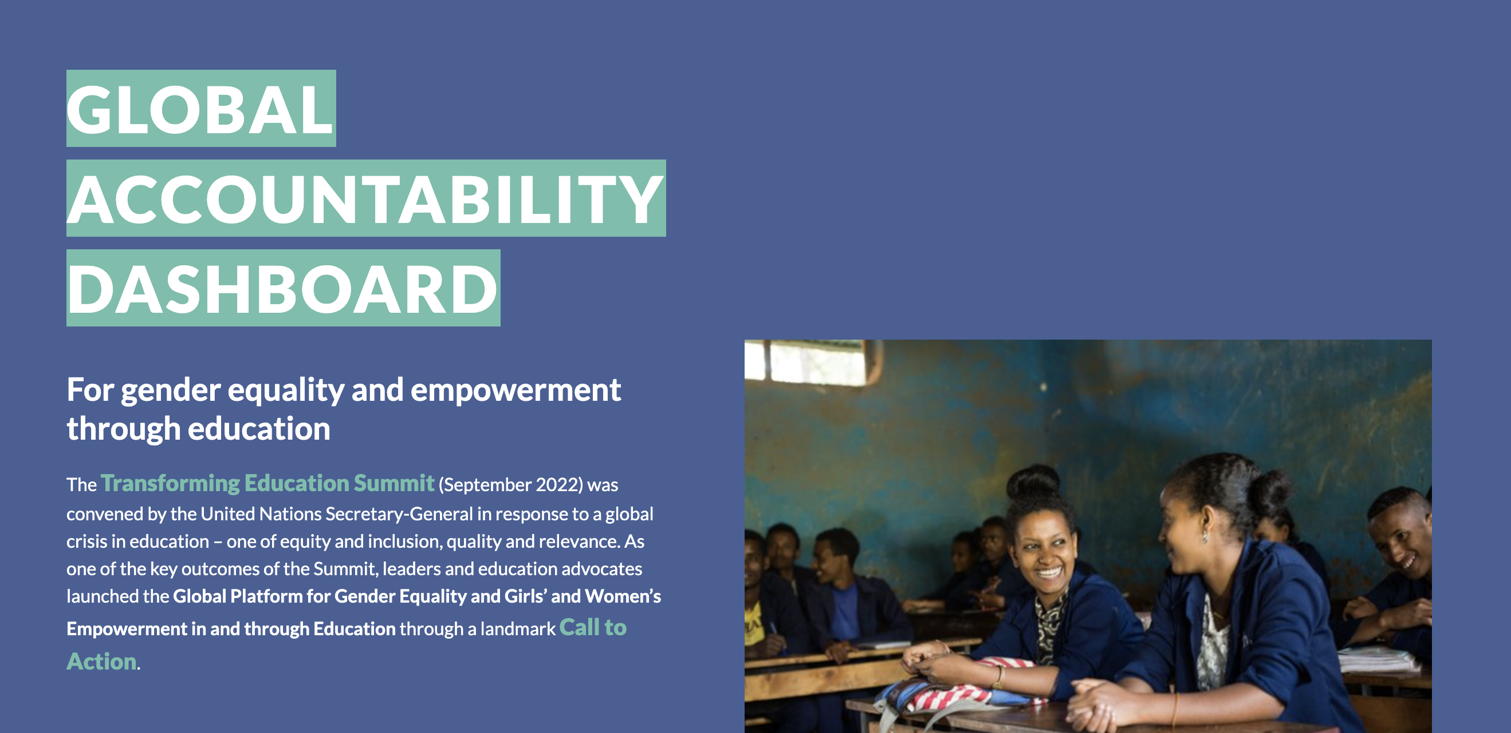
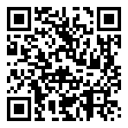
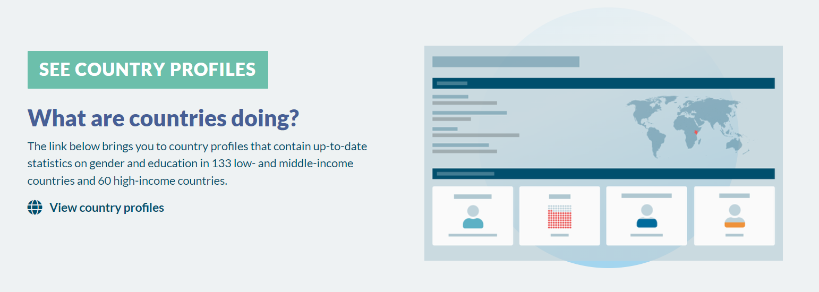
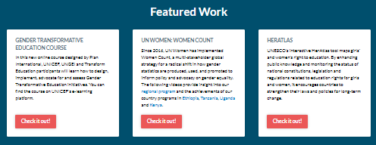
Driving follow-up to the Transforming Education Summit
Check out the
Dashboard today!
Section of Education for Inclusion and Gender Equality

Slide 16
Justine Sass,
Chief, Section of Education for Inclusion and Gender Equality
E-mail: j.sass@unesco.org

