Slide 1



VVOB Cambodia
School-Related Gender-Based Violence
Gender-Responsive Pedagogy
Virak Uon, Strategic Education Advisor
Notes:
Merel

Slide 2
Contents
VVOB overview
Approaches
Research on SRGBV
SRGBV through GRP
Recommendations

Slide 3
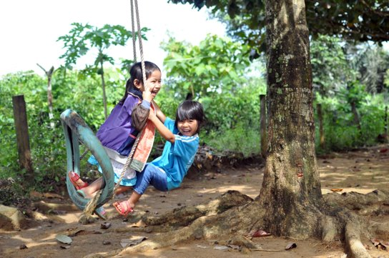
About VVOB | General
VVOB is a non-profit organization founded in 1982.
We support governments to sustainably improve education systems.
We are currently in 9 countries and have been in Cambodia since 2003.
Notes:
Our goal is capacity development for the system. Our closest partner is the Ministry of Education, Youth and Sport. Capacity development is our core business. We are always focused on how to build the capacity of our government partners in such a way that they can strengthen their education system. Therefore we are implementing a model of capacity development that Virak will elaborate on in a couple of minutes. But we’re always reflecting, evaluating and improving our CD modalities, which is why we’re happy to share with you today. It’s an opportunity to share our experience and to learn from you as well.

Slide 4

Our portfolio: 4 sub-sectors
Children
  Early childhood education
  Rwanda | South Africa | Uganda | Vietnam | Zambia
  Primary education
  Cambodia | Rwanda | South Africa | Uganda | Vietnam | Zambia
Youth
  General secondary education
  Cambodia | Kenya | Rwanda | South Africa | Uganda
  Secondary technical and vocational education and training (TVET)
  Ecuador | Uganda

Slide 5
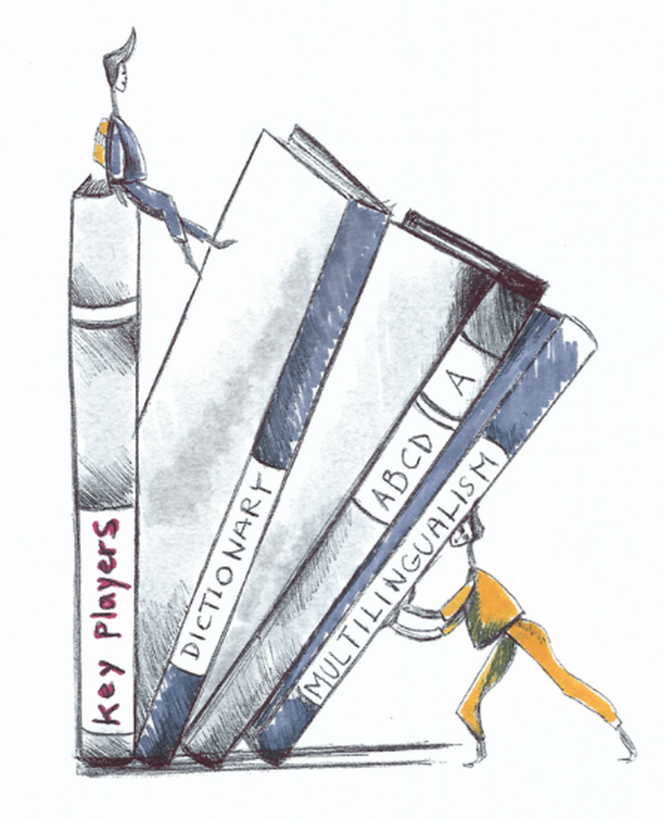
Our portfolio: 3 components
Teacher development
  Initial teacher education
  Teacher induction
  In-service teacher professional development
School leadership development
  Initial training
  Professional learning communities
(Gender) Equity
  Gender transformative pedagogy
  Classroom management

Slide 6

Our approach
Collaboration with and strengthening of government partners
  Building the capacity of the government to better provide quality education
  Provide (distance) coaching, mentoring and follow-up support
Facilitate scaling
  M&E and impact research for evidence building
  Support the government to develop a scaling strategy
Notes:
Mention the education sustainability checklist?

Slide 7
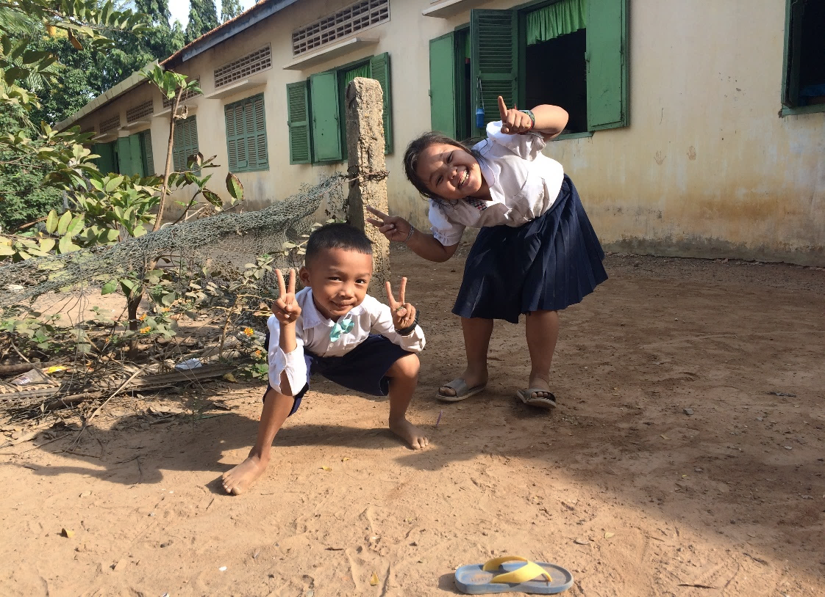
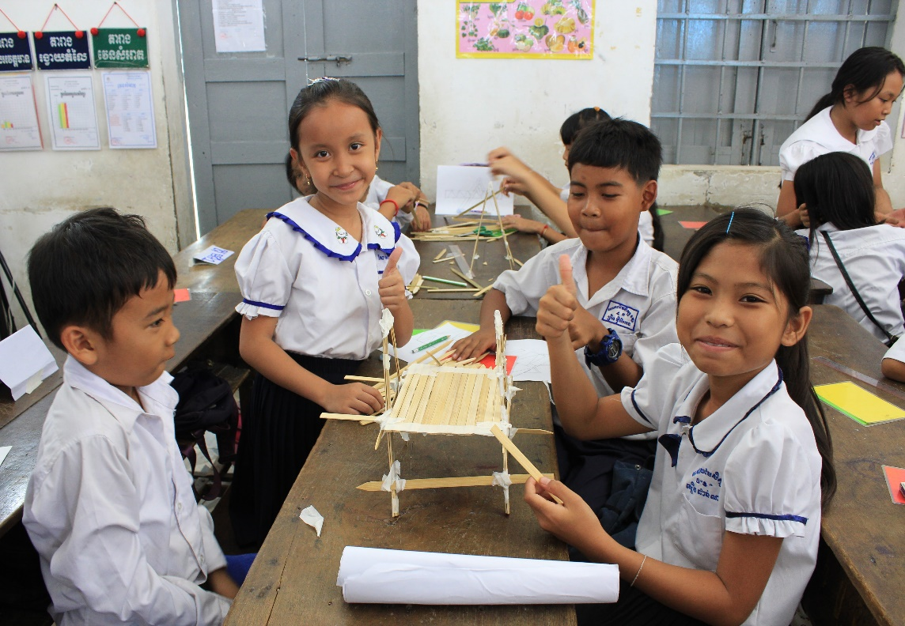
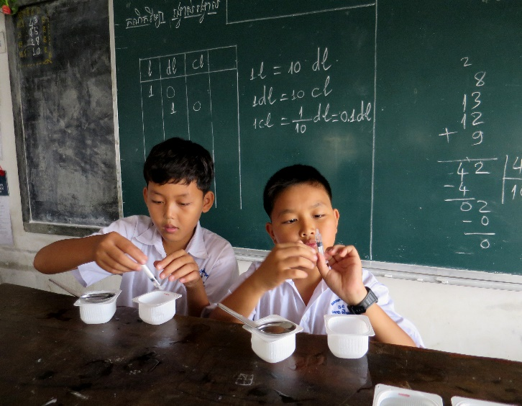

SRGBV through GRP
2017-2020 “ DGD – EU “
Teaching for Improved Gender Equality and Responsiveness “TIGER” project

Slide 8
SRGBV through GRP
To ensure primary and lower-secondary school children are protected from School-Related Gender-Based Violence (SRGBV) to enable equitable participation in all spheres of life.
Outcome
Transform the Battambang Teacher Education College (BTEC) and 40 schools into centres of excellence for gender-responsiveness.
Impact

Slide 9

Capacity development framework
Reduce SRGBV
Capacity development for teachers & leaders
Gender-responsive pedagogy teaching
Gender-responsive leadership
Continuous support for teachers by leaders
Coaching (in-person and online)

Slide 10


Outputs
Approach
Action Guide
Capacity development
Teachers → gender responsive pedagogy
School leaders → community engagement
School committee → parent involvement
Outreach, sensitization and communication
Ministry of Education, Ministry of Women Affairs – national and regional
Teacher training institute and schools
School community: school leaders, teachers, parents and students
Local NGO’s
COACHING
Multi-tiered & holistic → involving all levels:
Notes:
Multi-tiered capacity development approach
Different levels are crucial to influence gender identities, norms, expectations and relations
Supported by national level advocacy and grassroots level sensitization
Ministry of Education, Youth and Sport (MoEYS), Ministry of Women’s Affairs (MoWA), Provincial Office of Education (PoE), District Office of Education (DoE), Provincial Office of Women’s Affairs (PoWA) and District Office of Women’s Affairs (DoWA)
40 communities where the schools are located

Slide 11

SRGBV through GRP
Action Guide
Basic knowledge of gender
Gender Responsive Teaching and learning Methodology
Gender responsive Leadership
Gender Responsive Community Engagement
Resources from TIGER:
Action guide on teaching
Action guide on leadership
Stories of change
Storytelling app

Slide 12
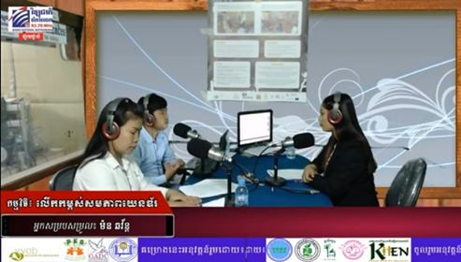
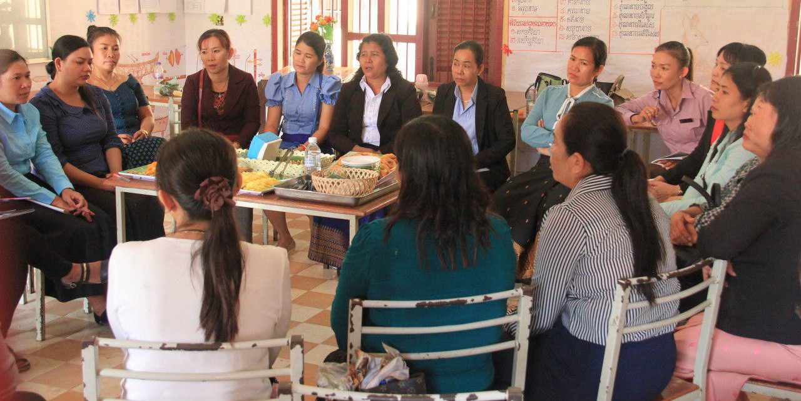
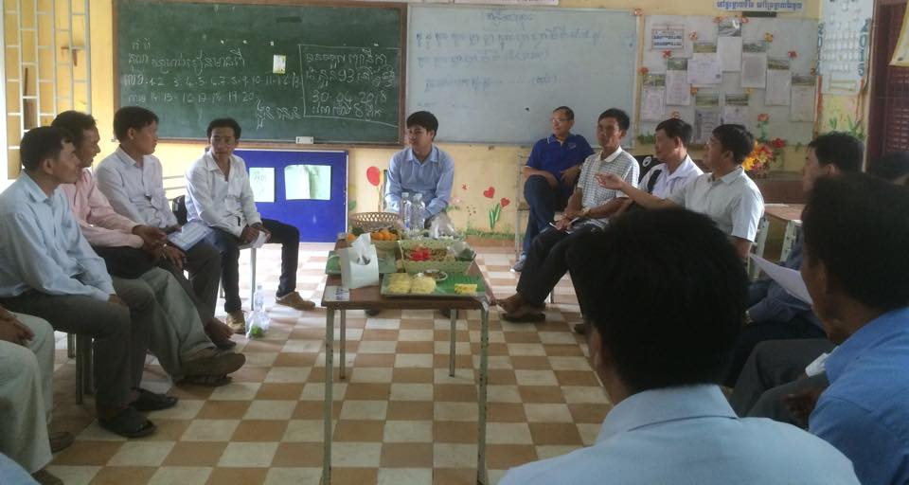
Gender Responsive Community Engagement
Radio Broadcasting
Campaign against violence against women and girls (8 March and 1 June 2019)
Gender Café
Men Dialogue
Notes:
Room for broadcasting and prepare the schedule of broadcasting 2 times/month
8 times of radio broadcasting and re-broadcasting 10 times
Select the national radio channel to continue broadcasting to promote gender awareness and education and to Prevent SRGBV.
Gender Café
2 times of gender café with female teacher that come from 20 target school in Battambang
Men Dialogue
01 times of men dialogue with male teacher that come from 19 target school in Battambang

Slide 13

SRGBV through GRP
105 staff of the Battambang Teacher Education College (BTEC)
40 primary and lower secondary schools
762 teachers, school leaders and school support committee members
5 third party civil society organizations (CSOs)
MoEYS and Ministry of Women’s Affairs (MoWA) staff at central and decentral levels
Gender-responsive schools
Gender-responsive teachers
Appx. 5,000 pupils in 40 primary and lower secondary schools

Slide 14
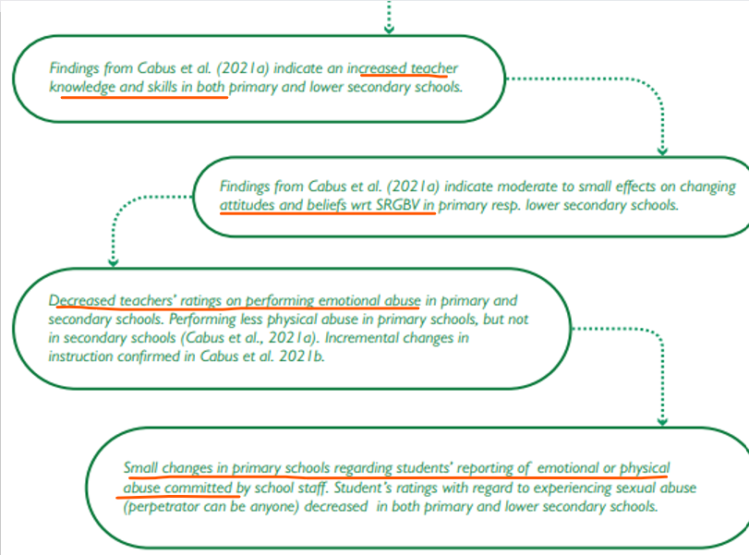
TIGER Impact
Research

Slide 15
Research
Tackling school-related gender-based violence through teacher professional development in Cambodia (2021)
Impact of gender-responsive and violence-free school environments on primary and lower secondary school children in Cambodia (2021)

Slide 16
Recommendations
Further scaling
  No donor funding available
  No government funding available
  However, similar SRGBV focused projects have been developed and implemented, e.g. Safe to Learn project
Integrated in new VVOB programme
  Gender responsive teaching integrated in MoEYS’ new Early Grade Math teaching and learning packages (currently being scaled to 8 provinces)
Notes:
Gender will become more prominent in future programmes since we have adopted a new gender-transformative policy last year.

